Slide 1
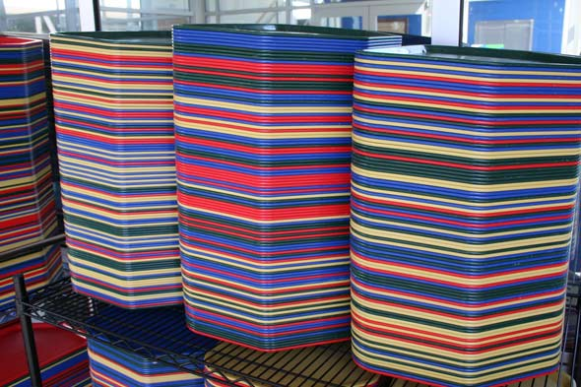
Stacks
Notes:
A stack is a data structure that is similar in spirit to a pile of cafeteria trays.
Think about the trays in the dining halls: when the dining staff put trays out before meals, they pile them from the bottom to the top, and then you take the top-most tray when you arrive. The last tray that the staff put on the piles is the first one taken from the pile.

Slide 2
push
pop
LIFO
Notes:
Similarly, with stacks, the last element inserted will be the first element retrieved. We'll refer to this pattern of insertion and retrieval as "last-in, first-out," or LIFO for short.
A stack's two primary operations are called push and pop. push places a new element on the top of the stack (like a dining hall's tray or a function's stack frame), and pop retrieves the topmost element from the stack, decrementing the stack's size in the process.
Like queues (and unlike arrays), stacks typically don't allow access to elements in the middle.

Slide 3
typedef struct
{
char* strings[CAPACITY];
int size;
}
stack;
{
Notes:
This is one way to define a stack for char*s.
CAPACITY is a constant and strings is a statically-sized array of char*s that you'll use for storing the char* elements.
size stores the number of elements currently in the stack. You'll need to adjust it appropriately so that you can track the location of the "top" of the stack.
Why is this design suboptimal? It imposes a limit on the size of the stack.

Slide 4
[5]
push TODOs:
size < CAPACITY?
store element at [size]
size++
[4]
[3]
[2]
[1]
[0]
Notes:
To push an element onto the stack, first make sure that the array isn't full by comparing size to CAPACITY.
If size < CAPACITY, store the element in the next available open slot, which should be at index [size].

Slide 5
[5]
pop TODOs:
size > 0?
size--
return [size]
[4]
[3]
[2]
[1]
[0]
Notes:
To pop an element off the stack, first make sure that there are elements in the array by checking whether size > 0.
If size > 0, decrement size and return the last element in the array, which should be at index [size].

